Slide 1

Linux Restricted Shell escape techniques
Offensive Security Tactics for Linux Professionals

Slide 2
What is a restricted shell?
A sandboxed/restricted shell environment which prevents the use of key binaries such as: cp, cat, bash, sh,
A usual shell just like bash however contains less functionality to contain a user further.
Notes:
So let’s start off by discussing what are restricted shells? Restricted shells are sandboxed environments which are designed to restrict the usual working shell capabilities of a Linux system. In other words it’s just like a normal bash shell but you’re restricted in terms of how you work with it.

Slide 3
Why use a restricted shell?
A sandboxed environment which prevents the use of key binaries which can be used in attempts of privilege escalation, acting as an additional layer of defence for the local system.
Preventing a systems administrator or user from doing any unintended damage to their machine.

Slide 4
Rbash escape techniques overview
Vi/Vim
find
ftp
gdb
AWK
Programming languages (Python, Perl, PHP, Ruby)
SSH
Environment variables (HISTFILE)
Notes:
A general overview of some bypass techniques which will be covered. Starting with text editors such as Vi/Vim, moving onto system binaries such as find, AWK, ftp, gdb and programming languages available within the restricted environment.
Binaries such as find, ftp, gdb have capabilities to interact with the local system which can help us to access Linux shells which are otherwise inaccessible in an rbash environment,.
SSH itself. Generally you will be accessing a black box technology which is only accessible via SSH or other open ports with the intent to keep you locked out of the system. However there are techniques which can be used in order to gain shell access to such systems with SSH as the access vector if all other binaries are not available for a potential rbash escape.

Slide 5


Vi/vim
Vi/Vim is a text editor which is usually installed by default on a large variety of Linux systems. When you find yourself in a restricted shell, this can act as a means of escape.
Vi/Vim is capable of executing system commands when accessed within a restricted shell environment by changing a key environment variable known as shell within Vi/Vim.

Slide 6
Vi/vim
When the shell variable is not configured correctly, you can change it to a working shell allowing an escape from within a restricted environment.
Upon configuring the environment, you are able to launch an available shell with the use of !/bin/bash executed within VI/VIM.

Slide 7
Find
A powerful Linux utility which can be used to query the Linux file system for specific directories and files.
Find has a program switch of -exec allowing the execution of commands and spawning a shell.

Slide 8
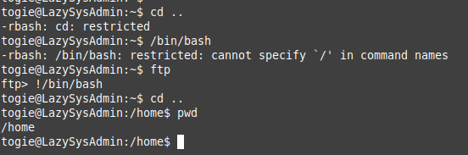
FTP
Possible to use system calls with the use of FTP. When the restricted bash shell does not let you make use of / in your commands. Bypass can be attempted with FTP.
Notes:
As seen here we are in an environment where using forward slashes are not allowed. We also can’t change directory out of the directory we’re currently in so we are restricted.

Slide 9
gdb
GNU debugger used for debugging C code. If such a binary is available in an rbash environment, you’re able to write to the file
If GDB is an available command, we can easily spawn a bash shell escaping the rbash instance.

Slide 10
AWK
Full support with the TCP stack allowing use of port scans, file transfers, spawning of bash, sh and other shells in addition to reverse/bind shells over the network using /inet/tcp.
AWK is generally used for filtering file columns but has support to launch a bash shell using its embedded programming language.

Slide 11
histfile
If you’re able to write to environment variables within a restricted bash environment, you should be able to write to a file outside of the restricted environment using a variable known as HISTFILE.
Using HISTFILE we can specify any located interested files such as authorized_keys file belonging to the owner of the account.
Any command written after inserting it into HISTFILE is then able to be written into the file itself. Allowing one method of trying to perform exploitation and interactions with system services despite being in rbash.

Slide 12
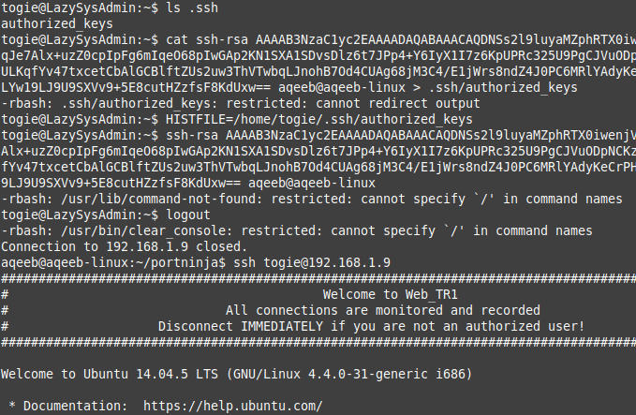
Histfile in action – The problem
Authorized_keys: Persistent Access
We can use ls to view properties of target
Blocked! Cannot use > to redirect output to file…
Notes:
We can make use of ls to list files and see what is interesting to write to. As long as we have permissions to write to the file/directory we should be able to use the HISTFILE variable to our advantage. In this case we can see the authorized keys file which can be listed however you are not able to write to it due to rbash preventing output. How to bypass this?

Slide 13
Histfile in action – The bypass
We can write to environment variables.
“History” is then recorded in our HISTFILE (New public key)
Logout/Login to then write the changes to file.

Slide 14
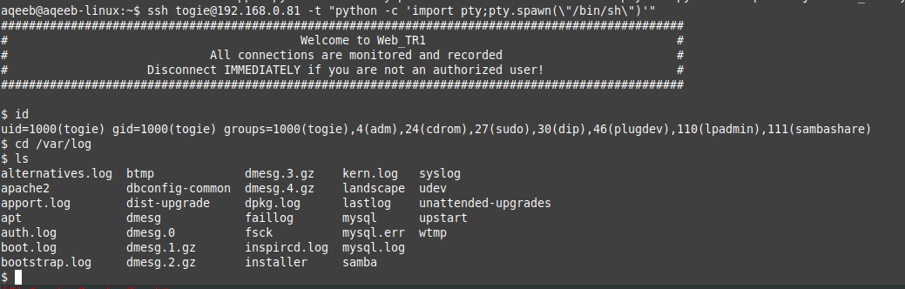
What if my target is using restricted shell over ssh?
SSH to the rescue! Using SSH “-t” switch, we can execute commands on the target machine before spawning a shell allowing for escape.

Slide 15
How do I know which commands I can use
Double tap of [tab] reveals the available commands in your restricted environment as seen in the image. (If the environment is configured to display commands)
If restricted shell is configured to not display commands you can use the beginning letter of each command followed by use of double tap of [tab] key.

Slide 16
Conclusion
Aspiring offensive security practitioners now have more techniques to use.
Current support staff making use of rbash can plan further restrictions on their current installations.
Future use of rbash can be used more securely with further review of attempting to bypass defences installed on the local server/network devices.

Slide 17

Questions

Slide 18

Next talk: Linux Network Defence Evasion

Slide 19
Thank you
Instructor: Aqeeb Hussain
GitHub: https://github.com/aqeebhussain122

